Slide 1
Canteen management system
Under the supervision of
Er. Bikash Chawal
Presented By:
Anisha Karki (770302)
Roji Prajapati (770333)
Shriya Shrestha (770342)
Sumina Awa (770345)
15 February 2023

Slide 2
TABLE OF CONTENTS
1
Introduction

Slide 3
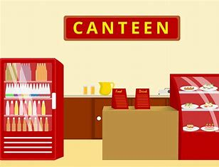
Introduction
A Canteen Management System is a computerized system that helps to manage the various operations of a canteen with high accuracy.
It can be used to manage product and customer details, orders, payments, processing invoice and sales report generation.
It is designed to automate the processes of canteen

Slide 4
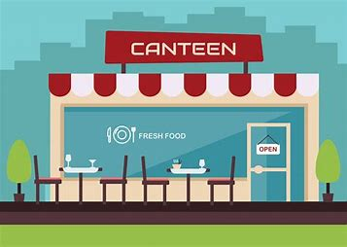

Motivation
The system would hold so many mechanisms and use advanced engineering algorithms.
Replacing the traditional way of managing canteen with the new way of ordering, billing and tracking the sales.
Provide us an opportunity to strengthen them, and learn something new on the way.

Slide 5

Objectives
To develop an user-friendly canteen management system.

Slide 6

Scope and application
It is a convenient method for ordering food and invoice generation
The customer do not have to wait in queue for a long time.
It has efficient log in system for the administration.
Generation of the financial report
Easy modification of the product details by admin

Slide 7
TABLE OF CONTENTS
1
Introduction

Slide 8
TABLE OF CONTENTS
a
Introduction
2
Methodology

Slide 9
Methodology
Problem Analysis
Research
Algorithm & Flowchart
Data Gathering
Coding
Compilation & Execution
Debugging & Testing
Documentation

Slide 10
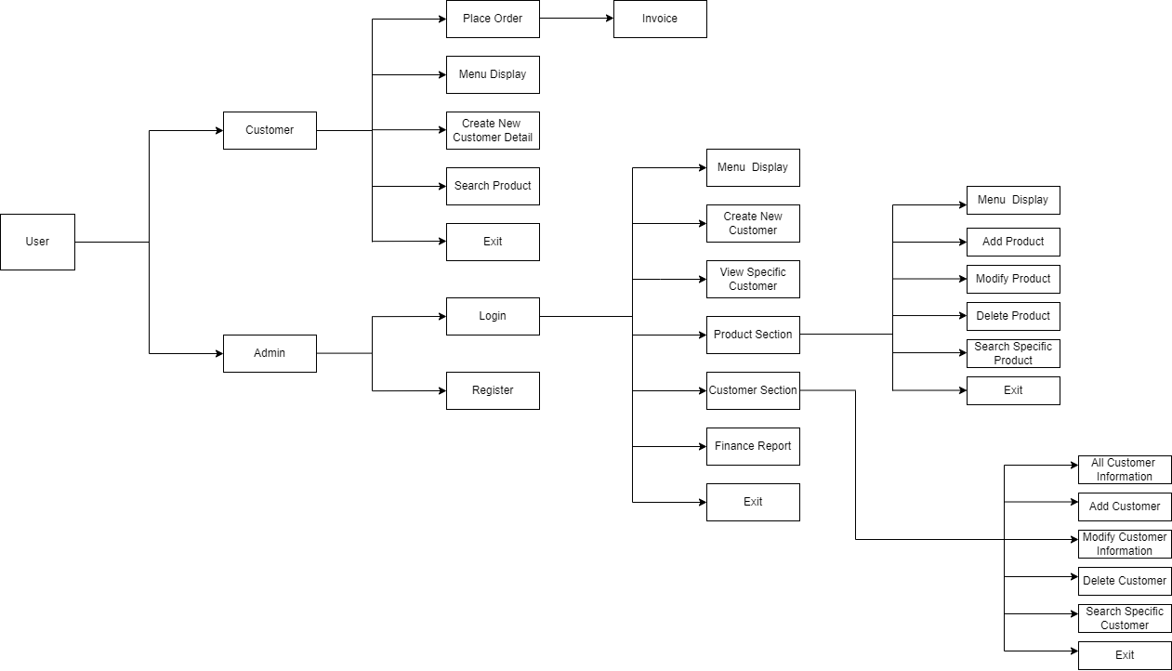
Block Diagram

Slide 11
Algorithm
Step 1: Start
Step 2: Initialize all the variables
Step 3: If user is admin, go to step 4 else go to step 8
Step 4: Display login/register
Step 5: If the user selects Register then
if the username is already occupied by others, print username not available and go to step 4
else display registration successful and go to step 4 for log in process
Step 6: If the user selects Login, open the admin home page if the username and password is correct i.e. go to step 7
else print unauthorized and go to step 4

Slide 12
Algorithm
Continued
Step 7: Input the valid option from admin home page and perform the following operation according to the option inputted and then go to step 6
if admin selects the menu, display menu
else if admin selects create new customer, new customer information are inputted and stored in the customer file
else if admin selects view specific customer, customer id is inputted and searched
else if admin selects customer details, access the option for modifying customer details, displaying all customer details
else if admin selects product information, access the option to edit menu, add menu, display menu
else if admin select the financial report, generate the sales report
else if admin selects exit go to step 9
Step 8: Input the valid option from the user home page and perform the following operations and then again go to step 8
if user select the order placement option, take order and generate the invoice
else if user select menu option, display menu
else if user selects create new customer, details are inputted and a new id is created and submitted
else if user selects search product, the product id is inputted from user and the searched product is displayed.
else if user select exit go to step 9
Step 9: Stop

Slide 13
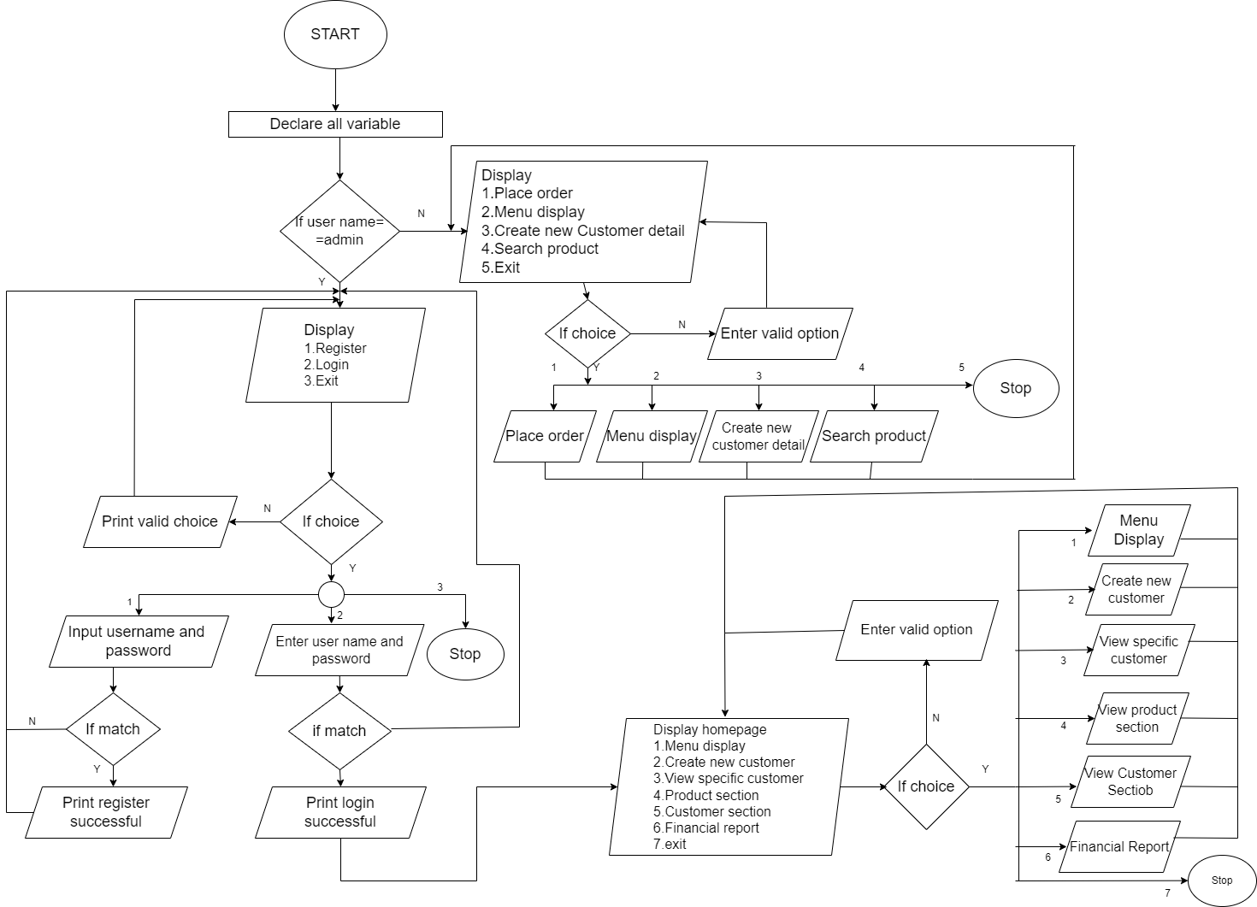
Flowchart

Slide 14
TABLE OF CONTENTS
a
Introduction
2
Methodology

Slide 15
TABLE OF CONTENTS
a
Introduction
a
Methodology
3
Features

Slide 16
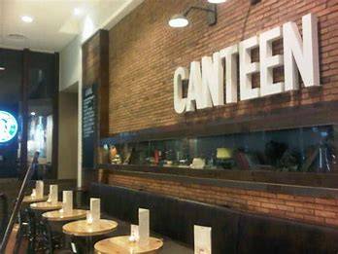

Features
It has different user and admin interface
The admin log in for authorization to get access
The menu items can be added, removed or deleted only be admin.
There is easy billing and order placement with invoice generation.
The financial report gets updated with the time when the order is placed.

Slide 17
TABLE OF CONTENTS
a
Introduction
a
Methodology
3
Features

Slide 18
TABLE OF CONTENTS
a
Introduction
a
Methodology
a
Features
4
Results and Outcomes

Slide 19
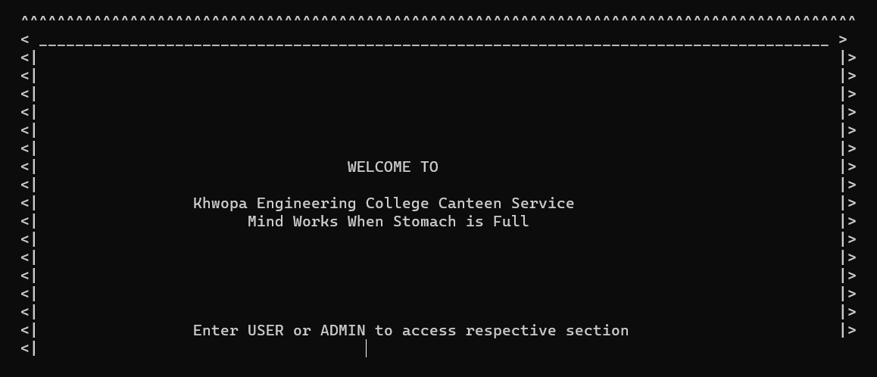
RESULTS AND OUTCOMES
Welcome Page

Slide 20
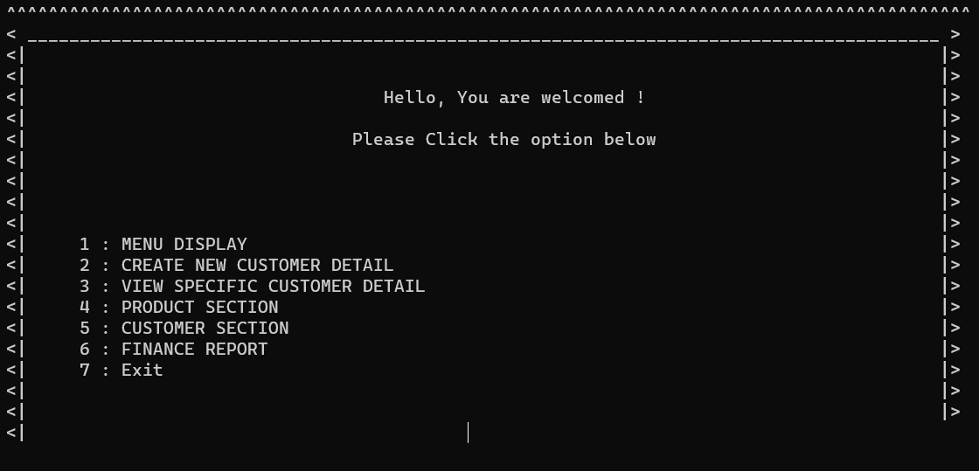
RESULTS AND OUTCOMES
Admin Home Page

Slide 21
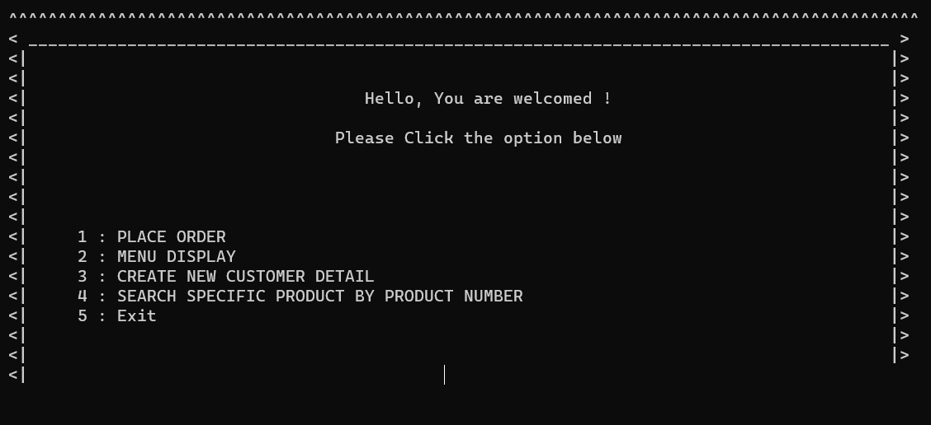
RESULTS AND OUTCOMES
User Home Page

Slide 22
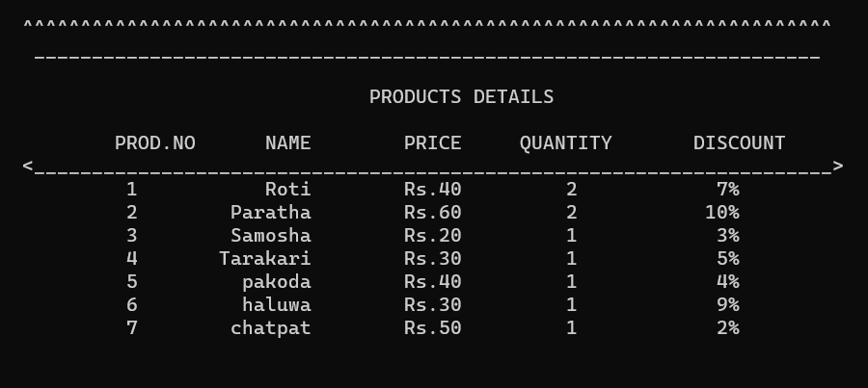
RESULTS AND OUTCOMES
Menu

Slide 23
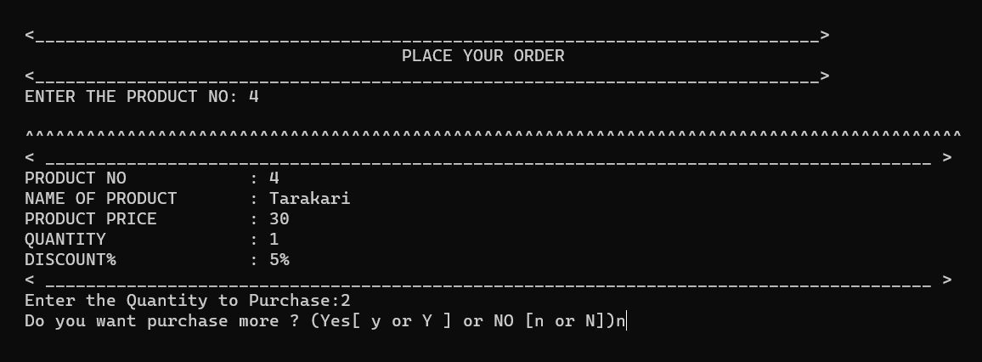
RESULTS AND OUTCOMES
Order Placement

Slide 24
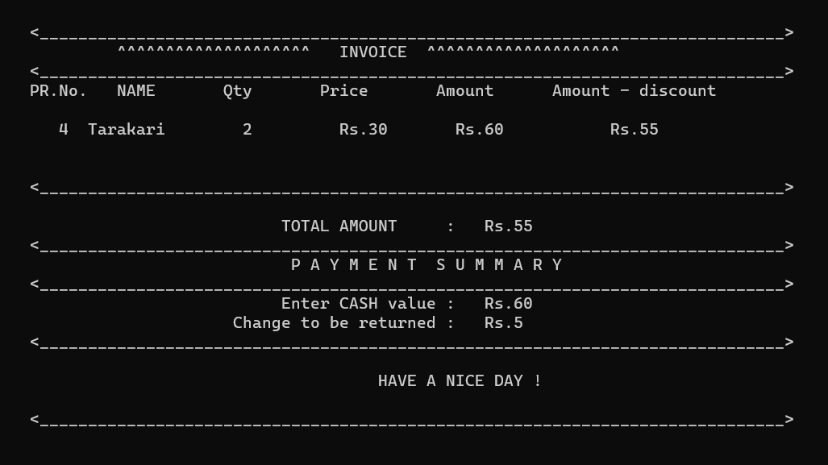
RESULTS AND OUTCOMES
Invoice

Slide 25
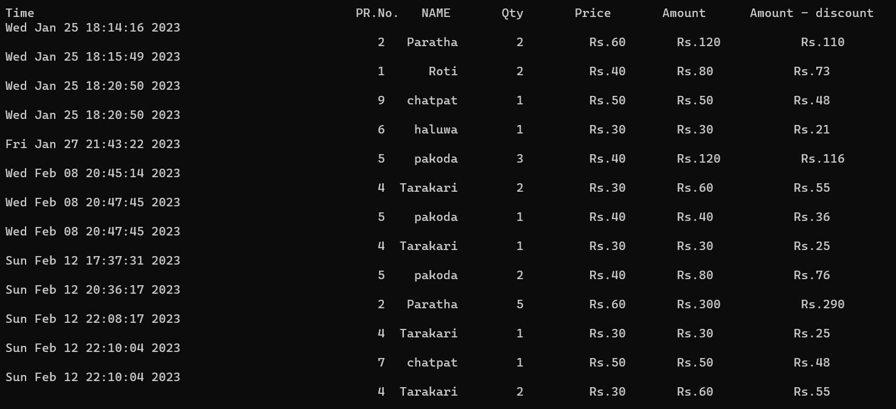
RESULTS AND OUTCOMES
Financial report

Slide 26
TABLE OF CONTENTS
a
Introduction
a
Methodology
a
Features
4
Results and Outcomes

Slide 27
TABLE OF CONTENTS
a
Introduction
a
Methodology
a
Features
a
Results and Outcomes
5
Limitations and Conclusion

Slide 28
Limitations
Production of the financial report generation on the specific period of time

Slide 29
CONCLUSION
To sum up, the Canteen Management System is made using C++ language.

Slide 30
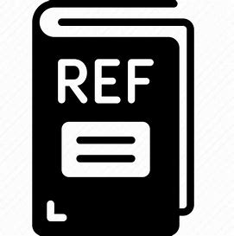
REFERENCES
Modern Canteen Management System Software in 2022 |EfroTech [20 August 2022]
Sikha Pardhidas, Canteen management system [22 August 2022]
Our Story: Canteen - Canteen [22 August 2022]

Slide 31
Thank you
Q/A

